Slide 1
Array
Lecture Week 3
Based on Slides of Dr. Norazah Yusof

Slide 2
Introducing Arrays
Array is a data structure that represents a collection of the same types of data.
In Java, array is an object that can store a group of values, all of the same type.

Slide 3
Declare and create an array
Declare and create array is similar to create and create any other type of object.
Example question:
  Declare and create 10-element double array referenced by the variable, myList.

Slide 4
Declare and create an array in two steps
Step 1: declare an array reference
datatype[] arrayRefVar;
or
datatype arrayRefVar[]; // This style is allowed, // but not preferred
Step 2: create an array
arrayRefVar = new datatype[arraySize];
Example
double[] myList;
myList = new double[10];

Slide 5
Declare and create an array in one step
Declare and create the array
datatype[] arrayRefVar = new datatype[arraySize];
or
datatype arrayRefVar[] = new datatype[arraySize];
Example
double[] myList = new double[10];
or
double myList[] = new double[10];

Slide 6
The Length of an Array
Once an array is created, its size is fixed. It cannot be changed. You can find its size using
arrayRefVar.length
For example,
    myList.length
    returns 10

Slide 7
Default Values
When an array is created, its elements are assigned the default value of
  0 for the numeric primitive data types,
  '\u0000' (unicode value) for char types, and
  false for boolean types.

Slide 8
Arrays
Subscript
  Integer contained within square brackets
  Indicates one of array’s variables or elements
double[] myList = new double[10];
myLis
t
reference
0
myList[0]
myList[1]
0
Array reference
myList[2]
0
variable
myList[3]
0
myList[4]
0
Array element at
myList[5]
0
Element value
index 5
myList[6]
0
myList[7]
0
myList[8]
0
myList[9]
0

Slide 9
Arrays
Array’s elements numbered beginning with zero
  Can legally use any subscript from 0 through myList.length-1
double[] myList = new double[10];
myLis
t
reference
0
myList[0]
myList[1]
0
Array reference
myList[2]
0
variable
myList[3]
0
myList[4]
0
Array element at
myList[5]
0
Element value
index 5
myList[6]
0
myList[7]
0
myList[8]
0
myList[9]
0

Slide 10
Self- test 1
Identify and correct the syntax error in each of the following array declaration.
(a) int arr = new int[15];
(b) int arr[] = new int(15);
(c) float arr[] = new [3];

Slide 11
Answer of Self- test 1
Identify and correct the syntax error in each of the following array declaration.
int arr = new int[15];
  There are missing brackets after arr.
(b) int arr[] = new int(15);
There are parentheses instead of brackets around 15
(c) float arr[] = new [3];
  It should be new float[3] instead of new [3].

Slide 12
Self test - 2
Lab 5 Exercise 3:
Write the correct Java statement that declare and create the following arrays:
A 15-element double array referenced by the variable areaOfCircle.
A 50-element string array referenced by the variable staffName.
A 25-element int array referenced by the variable total.
A 100-element double array referenced by the variable gpa that stores the Grade Point Average of the students.
datatype[] arrayRefVar = new datatype[arraySize];

Slide 13
Accessing Array Elements
The array elements are accessed through the index, known as indexed variable
arrayRefVar[index];
An indexed variable can be used in the same way as a regular variable.
For example, the value of the array element may be assigned as follows:
myList[0] = 5.6;
myList[1] = myList[0] – 1.1;
Scanner inp = new Scanner(System.in);
myList[2] = inp.nextDouble();

Slide 14
Accessing Array Elements
The array elements can be output using the println method.
System.out.println (myList[0]);
System.out.println (myList[1]);
System.out.println (myList[2]);

Slide 15
Write & Trace the output
class ArrayDemo {
  public static void main(String[] args) {
    int[] anArray; // declares an array of integers
    anArray = new int[10]; // allocates memory for 10 integers
    anArray[0] = 100; // initialize first element
    anArray[1] = 200; // initialize second element
    anArray[2] = 300; // etc.
    anArray[3] = 400;
    anArray[4] = 500;
    anArray[5] = 600;
    anArray[6] = 700;
    anArray[7] = 800;
    anArray[8] = 900;
    anArray[9] = 1000;

Slide 16
System.out.println("Element at index 0: " + anArray[0]);
System.out.println("Element at index 1: " + anArray[1]);
System.out.println("Element at index 2: " + anArray[2]);
System.out.println("Element at index 3: " + anArray[3]);
System.out.println("Element at index 4: " + anArray[4]);
System.out.println("Element at index 5: " + anArray[5]);
System.out.println("Element at index 6: " + anArray[6]);
System.out.println("Element at index 7: " + anArray[7]);
System.out.println("Element at index 8: " + anArray[8]);
System.out.println("Element at index 9: " + anArray[9]);
}
}

Slide 17
The output from this program is:
  Element at index 0: 100
    Element at index 1: 200
    Element at index 2: 300
    Element at index 3: 400
    Element at index 4: 500
    Element at index 5: 600
    Element at index 6: 700
    Element at index 7: 800
    Element at index 8: 900
    Element at index 9: 1000

Slide 18
Using loop to cycle through the entire array
Perform loops that vary loop control variable
    Start at 0
    End at one less than size of array
Using constant that is equal to size of array
  final int SIZE = 10;
for(int i = 0; i < SIZE; i++)
  myList[i] += 3;
Or using the length field, that contains the number of elements in array
for(int i = 0; i < myList.length; i++)
  myList[i] += 3;
Java Programming, Fourth Edition

Slide 19
Declaring, creating, initializing Using the Shorthand Notation
Declare and create the array
datatype[] arrayRefVar =
{arrylist1, arrylist2,…};
Example
double[] myList = {5.6, 4.5, 3.3, 13.2, 4, 34.33, 34, 45.45, 99.993, 11.3};

Slide 20
Declaring, creating, initializing Using the Shorthand Notation
double[] myList = {5.6, 4.5, 3.3, 13.2, 4, 34.33,
34, 45.45, 99.993, 11.3};
This shorthand notation is equivalent to the following statements:
double[] myList = new double[10];
myList[0] = 5.6; myList[1] = 4.5; myList[2] = 3.3;
myList[3] = 13.2; myList[4] = 4; myList[5] = 34.33;
myList[6] = 34; myList[7] = 45.45;
myList[8] = 99.993; myList[9] = 11.3;

Slide 21
CAUTION!!
Using the shorthand notation, you have to declare, create, and initialize the array all in one statement.
Splitting it would cause a syntax error. For example, the following is wrong:
  double[] myList;
  myList = {1.9, 2.9, 3.4, 3.5};

Slide 22
Arrays
Array’s elements numbered beginning with zero
  Can legally use any subscript from 0 through 9
double[] myList = new double[10];
myLis
t
reference
5.6
myList[0]
myList[1]
4.5
Array reference
myList[2]
3.3
variable
myList[3]
13.2
myList[4]
4
Array element at
myList[5]
34.33
Element value
index 5
myList[6]
34
myList[7]
45.45
myList[8]
99.993
myList[9]
11.3

Slide 23
Self- test 3
Identify and correct the syntax error in each of the following array declaration.
(a) float arr[] = new float {1.0,2.0,3.0};

Slide 24
Answer of Self- test 3
Identify and correct the syntax error in each of the following array declaration.
float arr[] = new float {1.0,2.0,3.0};
  new should not be there.

Slide 25
Self- test 4
Assume the array declaration and initialization is as follows.
  int arr[] = {2,4,6,8,10};
State whether it is valid/invalid?
(a) arr[4] (f) arr[ 5 % 2 ]
(b) arr[ arr.length ] (g) arr[ arr[ arr[0] ] ]
(c) arr[ arr[0] ] (h) arr[ 5 / 2.0 ]
(d) arr[ arr.length / 2 ] (i) arr[ arr[3] / 2]
(e) arr[ arr[1] ]

Slide 26
Answer of Self- test 4
Assume the array declaration and initialization is as follows.
  int arr[] = {2,4,6,8,10};
State whether it is valid/invalid?
(a) 10, (f) 4,
(b) invalid, (g) invalid
(c) 6, (h) invalid,
(d) 6, (i) 10
(e) 10,

Slide 27
Trace Program with Arrays
Given the following program, what will be the output?
public class Test {
public static void main(String[] args) {
int[] values = new int[5];
for (int i = 1; i < 5; i++) {
values[i] = i + values[i-1];
}
values[0] = values[1] + values[4];
}
}

Slide 28
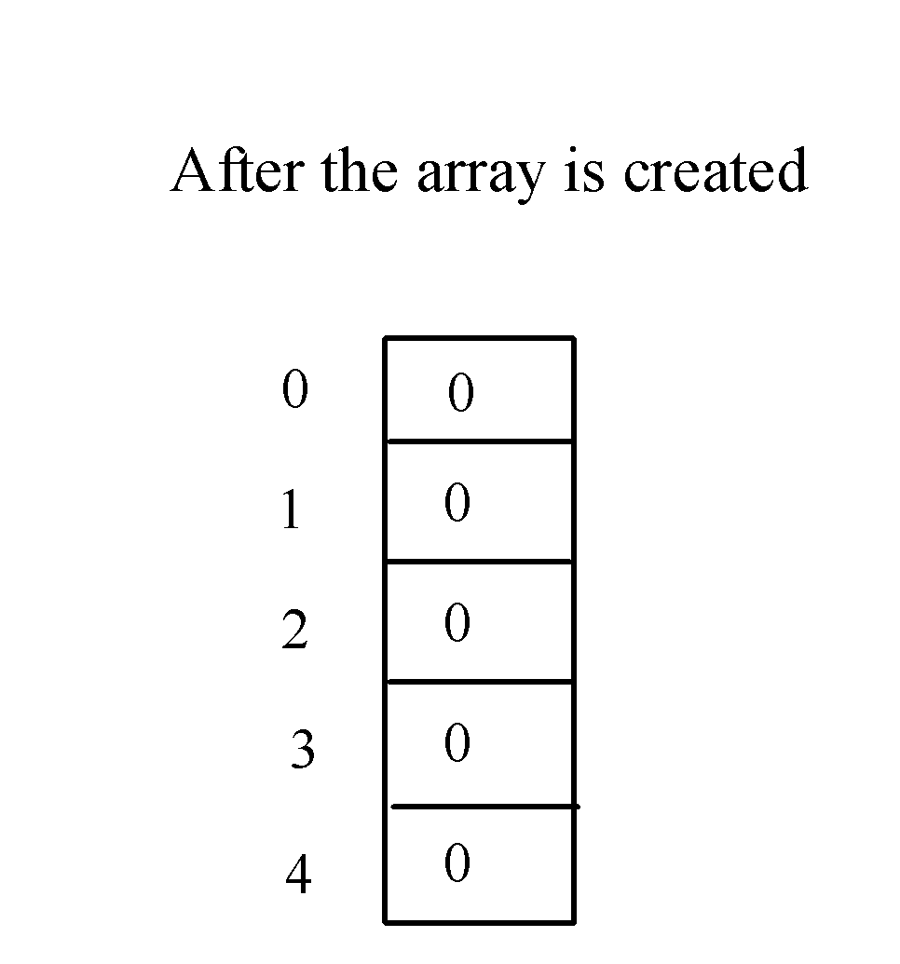
Trace Program with Arrays
Declare array variable values, create an array, and assign its reference to values
public class Test {
public static void main(String[] args) {
int[] values = new int[5];
for (int i = 1; i < 5; i++) {
values[i] = values[i] + values[i-1];
}
values[0] = values[1] + values[4];
}
}

Slide 29
Trace Program with Arrays
i becomes 1
public class Test {
public static void main(String[] args) {
int[] values = new int[5];
for (int i = 1; i < 5; i++) {
values[i] = values[i] + values[i-1];
}
values[0] = values[1] + values[4];
}
}

Slide 30
Trace Program with Arrays
i (=1) is less than 5
public class Test {
public static void main(String[] args) {
int[] values = new int[5];
for (int i = 1; i < 5; i++) {
values[i] = values[i] + values[i-1];
}
values[0] = values[1] + values[4];
}
}

Slide 31

Trace Program with Arrays
After this line is executed, value[1] is 1
public class Test {
public static void main(String[] args) {
int[] values = new int[5];
for (int i = 1; i < 5; i++) {
values[i] = i + values[i-1];
}
values[0] = values[1] + values[4];
}
}

Slide 32

Trace Program with Arrays
After i++, i becomes 2
public class Test {
public static void main(String[] args) {
int[] values = new int[5];
for (int i = 1; i < 5; i++) {
values[i] = values[i] + values[i-1];
}
values[0] = values[1] + values[4];
}
}

Slide 33

Trace Program with Arrays
i (= 2) is less than 5
public class Test {
public static void main(String[] args) {
int[] values = new int[5];
for (int i = 1; i < 5; i++) {
values[i] = values[i] + values[i-1];
}
values[0] = values[1] + values[4];
}
}

Slide 34

Trace Program with Arrays
After this line is executed,
values[2] is 3 (2 + 1)
public class Test {
public static void main(String[] args) {
int[] values = new int[5];
for (int i = 1; i < 5; i++) {
values[i] = i + values[i-1];
}
values[0] = values[1] + values[4];
}
}

Slide 35
Trace Program with Arrays
After this, i becomes 3.
public class Test {
public static void main(String[] args) {
int[] values = new int[5];
for (int i = 1; i < 5; i++) {
values[i] = i + values[i-1];
}
values[0] = values[1] + values[4];
}
}

Slide 36
Trace Program with Arrays
i (=3) is still less than 5.
public class Test {
public static void main(String[] args) {
int[] values = new int[5];
for (int i = 1; i < 5; i++) {
values[i] = i + values[i-1];
}
values[0] = values[1] + values[4];
}
}

Slide 37

Trace Program with Arrays
After this line, values[3] becomes 6 (3 + 3)
public class Test {
public static void main(String[] args) {
int[] values = new int[5];
for (int i = 1; i < 5; i++) {
values[i] = i + values[i-1];
}
values[0] = values[1] + values[4];
}
}

Slide 38
Trace Program with Arrays
After this, i becomes 4
public class Test {
public static void main(String[] args) {
int[] values = new int[5];
for (int i = 1; i < 5; i++) {
values[i] = i + values[i-1];
}
values[0] = values[1] + values[4];
}
}

Slide 39
Trace Program with Arrays
i (=4) is still less than 5
public class Test {
public static void main(String[] args) {
int[] values = new int[5];
for (int i = 1; i < 5; i++) {
values[i] = i + values[i-1];
}
values[0] = values[1] + values[4];
}
}

Slide 40

Trace Program with Arrays
After this, values[4] becomes 10 (4 + 6)
public class Test {
public static void main(String[] args) {
int[] values = new int[5];
for (int i = 1; i < 5; i++) {
values[i] = i + values[i-1];
}
values[0] = values[1] + values[4];
}
}

Slide 41

Trace Program with Arrays
After i++, i becomes 5
public class Test {
public static void main(String[] args) {
int[] values = new int[5];
for (int i = 1; i < 5; i++) {
values[i] = i + values[i-1];
}
values[0] = values[1] + values[4];
}
}

Slide 42
Trace Program with Arrays
i ( =5) < 5 is false. Exit the loop
public class Test {
public static void main(String[] args) {
int[] values = new int[5];
for (int i = 1; i < 5; i++) {
values[i] = i + values[i-1];
}
values[0] = values[1] + values[4];
}
}

Slide 43
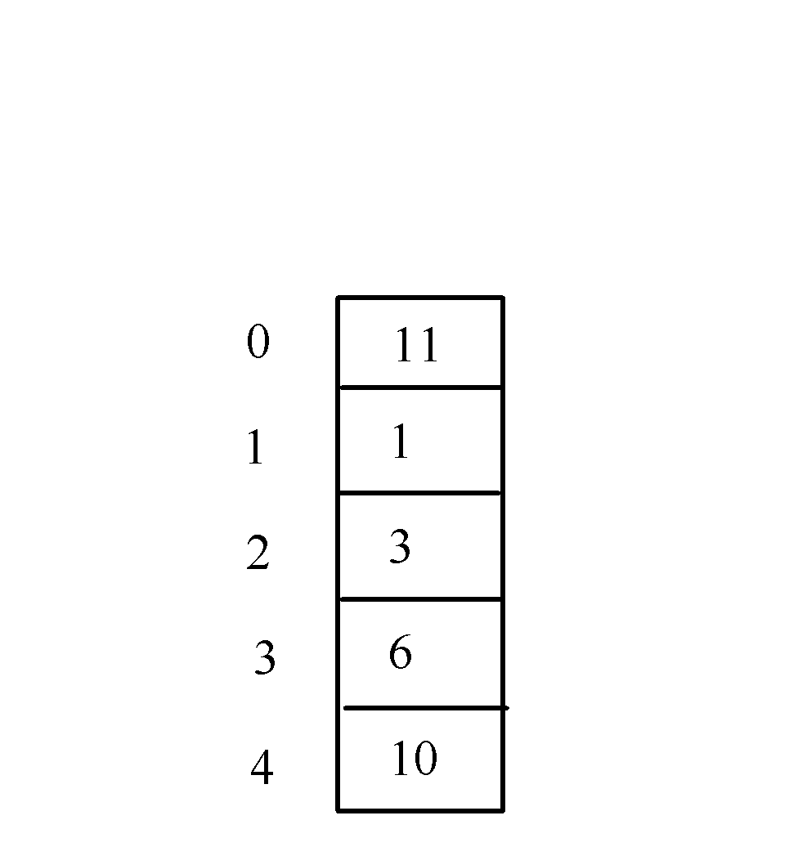
Trace Program with Arrays
After this line, values[0] is 11 (1 + 10)
public class Test {
public static void main(String[] args) {
int[] values = new int[5];
for (int i = 1; i < 5; i++) {
values[i] = i + values[i-1];
}
values[0] = values[1] + values[4];
}
}

Slide 44
Enhanced for Loop
JDK 1.5 and above introduced a new for loop that enables you to traverse the complete array sequentially without using an index variable. For example, the following code displays all elements in the array scoreArray:
for(int val : scoreArray)
    System.out.println(val);
In general, the syntax is
for (elementType value: arrayRefVar) {
  // Process the value
  }
You still have to use an index variable if you wish to traverse the array in a different order or change the elements in the array.

Slide 45
Array Processing
(Printing arrays)
(Summing all elements)
(Finding the largest element)
(Finding the smallest index of the largest element)

Slide 46
Example: Print an Array
Print an array of int and an array of double:
These must be static ...
public class PrintArrays {
static final int ARRSIZE = 10; // The array's size
static int intArr[] = new int[ARRSIZE]; // Create the int array
static double realArr[] = { 1.1, 2.2, 3.3, 4.4,
5.5, 6.6, 7.7, 8.8, 9.9, 10.10 }; // And a double array
public static void main(String args[]) {
System.out.println("Ints \t Reals");
for (int k = 0; k < intArr.length; k++)
System.out.println( intArr[k] + " \t " + realArr[k]);
} // main()
} // PrintArrays
Program Output
Ints Reals
0 1.1
0 2.2
0 3.3
0 4.4
0 5.5
0 6.6
0 7.7
0 8.8
0 9.9
0 10.1
… in order to refer to them in static main()
Uninitialized int array has default values of 0.

Slide 47
Example: Store the First 100 Squares
public class Squares {
static final int ARRSIZE = 100; // The array's size
static int intArr[] = new int[ARRSIZE]; // Create an int array
public static void main(String args[]) {
for (int k = 0; k < intArr.length; k++) // Initialize the array
intArr[k] = (k+1) * (k+1);
System.out.print("The first 100 squares are"); // Print a heading
for (int k = 0; k < intArr.length; k++)
{ // Print the array
if (k % 10 == 0)
System.out.println(" "); // 10 elements per row
System.out.print( intArr[k] + " ");
} // for
} // main()
} // Squares
Program Output
The first 100 squares are
1 4 9 16 25 36 49 64 81 100
121 144 169 196 225 256 289 324 361 400
441 484 529 576 625 676 729 784 841 900
961 1024 1089 1156 1225 1296 1369 1444 1521 1600
1681 1764 1849 1936 2025 2116 2209 2304 2401 2500
2601 2704 2809 2916 3025 3136 3249 3364 3481 3600
3721 3844 3969 4096 4225 4356 4489 4624 4761 4900
5041 5184 5329 5476 5625 5776 5929 6084 6241 6400
6561 6724 6889 7056 7225 7396 7569 7744 7921 8100
8281 8464 8649 8836 9025 9216 9409 9604 9801 10000

Slide 48
Exercise 1 (Question 1)
Modify program ArrayDemo and save as ArrayDemo1
Initialize the elements in one initialization statement
class ArrayDemo {
  public static void main(String[] args) {
    int[] anArray; // declares an array of integers
    anArray = new int[10]; // allocates memory for 10 integers
    anArray[0] = 100; // initialize first element
    anArray[1] = 200; // initialize second element
    anArray[2] = 300; // etc.
    anArray[3] = 400;
    anArray[4] = 500;
    anArray[5] = 600;
    anArray[6] = 700;
    anArray[7] = 800;
    anArray[8] = 900;
    anArray[9] = 1000;
double[] myList = {5.6, 4.5, 3.3, 13.2, 4, 34.33,
34, 45.45, 99.993, 11.3};

Slide 49
Exercise 1 (Question 1) cont.
Use traditional for loop to print all the values
System.out.println("Element at index 0: " + anArray[0]);
System.out.println("Element at index 1: " + anArray[1]);
System.out.println("Element at index 2: " + anArray[2]);
System.out.println("Element at index 3: " + anArray[3]);
System.out.println("Element at index 4: " + anArray[4]);
System.out.println("Element at index 5: " + anArray[5]);
System.out.println("Element at index 6: " + anArray[6]);
System.out.println("Element at index 7: " + anArray[7]);
System.out.println("Element at index 8: " + anArray[8]);
System.out.println("Element at index 9: " + anArray[9]);
}
}

Slide 50
class ArrayDemo1 {
public static void main(String[] args) {
int anArray[] = {100, 200, 300, 400,
500, 600, 700, 800, 900, 1000};
for (int i = 0; i < anArray.length; i++) {
System.out.println("Element at
index" + i + ": " + anArray[i]);
}
}
}

Slide 51
Exercise 1 (Question 2) cont.
Modify program ArrayDemo1 and save as ArrayDemo2
Use enhanced for loop / for-each loop to print all the values

Slide 52
class ArrayDemo2 {
public static void main(String[] args) {
int anArray[] = {100, 200, 300, 400,
500, 600, 700, 800, 900, 1000};
for (int i: anArray) {
System.out.println(i);
}
}
}

Slide 53
The output from this program is:
  Element at index 0: 100
    Element at index 1: 200
    Element at index 2: 300
    Element at index 3: 400
    Element at index 4: 500
    Element at index 5: 600
    Element at index 6: 700
    Element at index 7: 800
    Element at index 8: 900
    Element at index 9: 1000

Slide 54
Example: Testing Arrays
Objective: Write a program that receives 6 numbers from the user, finds the largest number and counts the occurrence of the largest number entered.
Suppose you entered 3, 5, 2, 5, 5, and 5, the largest number is 5 and its occurrence count is 4.

Slide 55
Example: Testing Arrays
Create an int array sized 6
Loop array-length times to receive the input from keyboard using scanner class
Compare a pair numbers and store the larger
Count the occurrences

